Slide 1


NexusAD: Exploring the Nexus for Multimodal Perception and Comprehension of Corner Cases in Autonomous Driving Track 1 | Corner Case Scene Understanding Trustworthy Visual Intelligence Group Mengjingcheng Mo, Jingxin Wang, Like Wang, Haosheng Chen, Changjun Gu, Jiaxu Leng *, Xinbo Gao*
Chongqing University of Posts and Telecommunications
Speaker: Mengjingcheng Mo
Workshop W-CODA
Sep. 30th, 2024 (Mon)
Notes:
Hello everyone! Thank you for being here. I’m Mengjingcheng Mo, from Chongqing University of Posts and Telecommunications, representing the NexusAD team. I’ll be presenting our work on Multimodal Perception and Comprehension of Corner Cases in Autonomous Driving. Let’s dive into our approach and the insights we've gained through this research.

Slide 2



Outline
Dataset & Tasks
Challenge
Method
Analysis
Results
Notes:
Here’s a quick outline of the presentation. I’ll cover the dataset and tasks, discuss the challenges we faced, explain our method, and then go through the analysis and results.

Slide 3
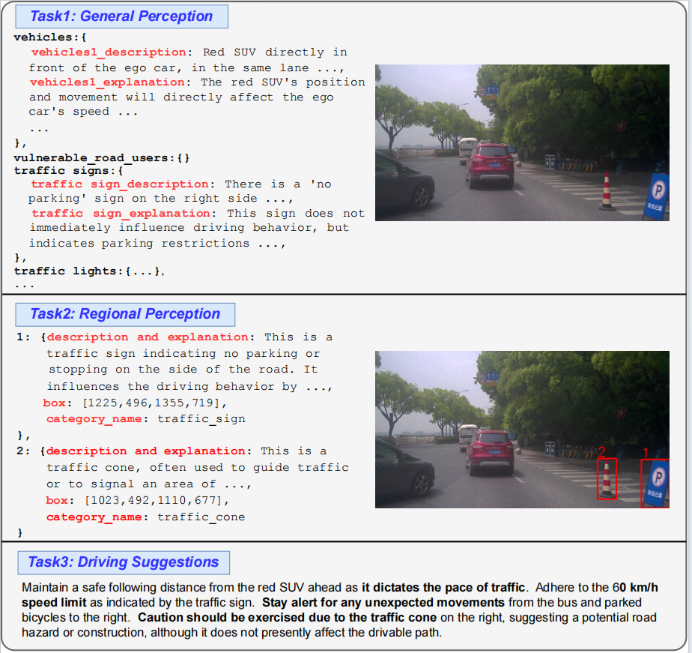
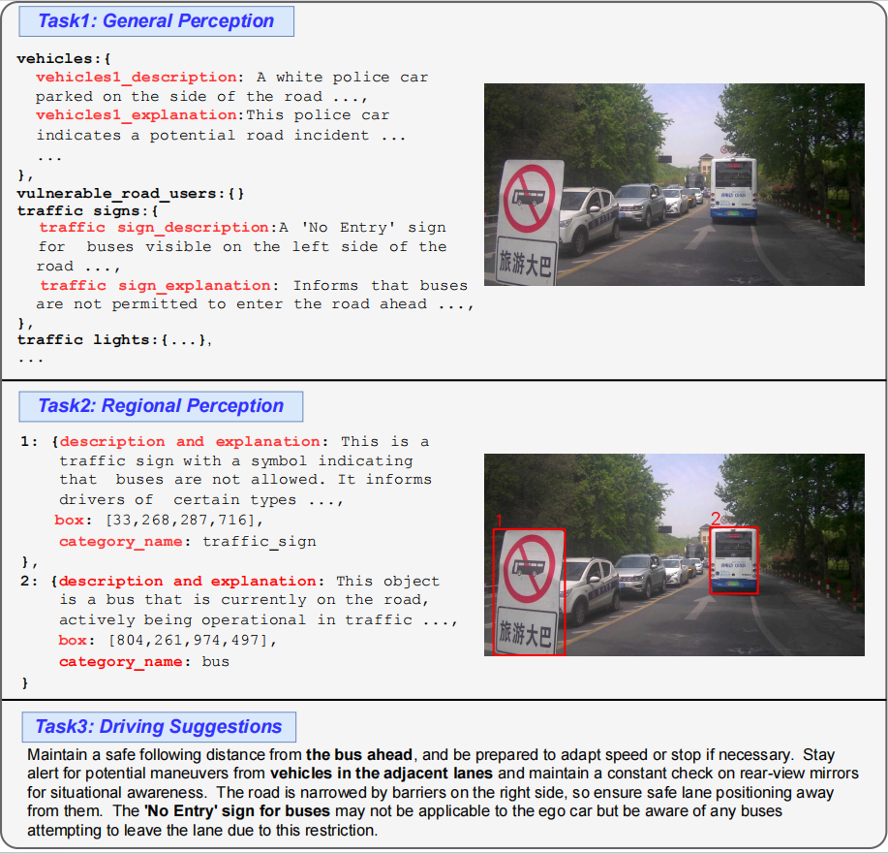
Dataset & Tasks
This competition is dedicated to enhancing multimodal perception and comprehension capabilities of MLLMs for autonomous driving, focusing on the General Perception, Regional Perception, and Driving Suggestions.
[A] Li Yanze et al., Automated evaluation of large vision-language models on self-driving corner cases, in arXiv preprint: 2404.10595, 2024.
Notes:
Our tasks focus on three areas: General Perception, which identifies vehicles and signs, Regional Perception, which analyzes specific regions, and Driving Suggestions, which offers driving guidance. Together, these tasks help improve autonomous systems in complex environments.

Slide 4
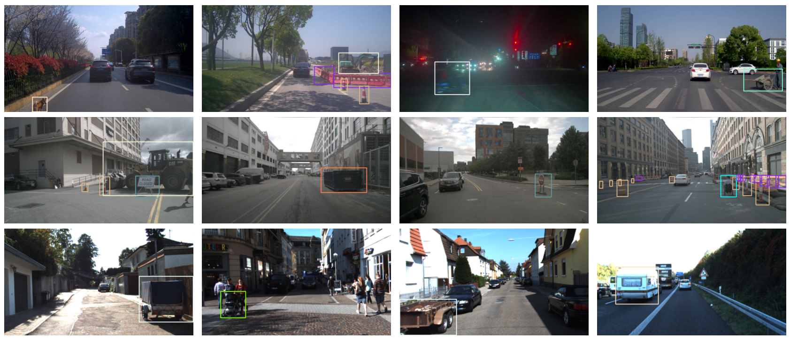
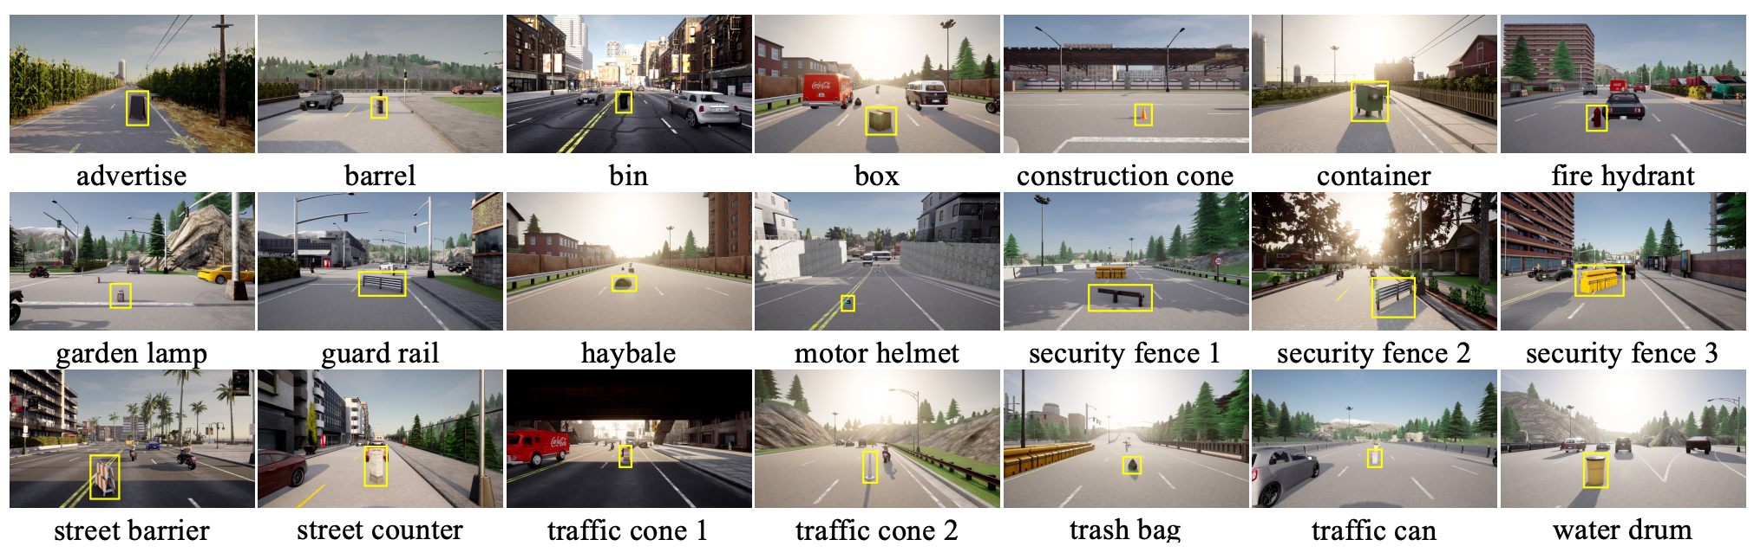
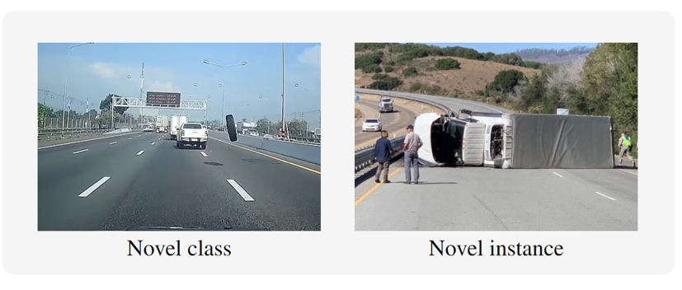
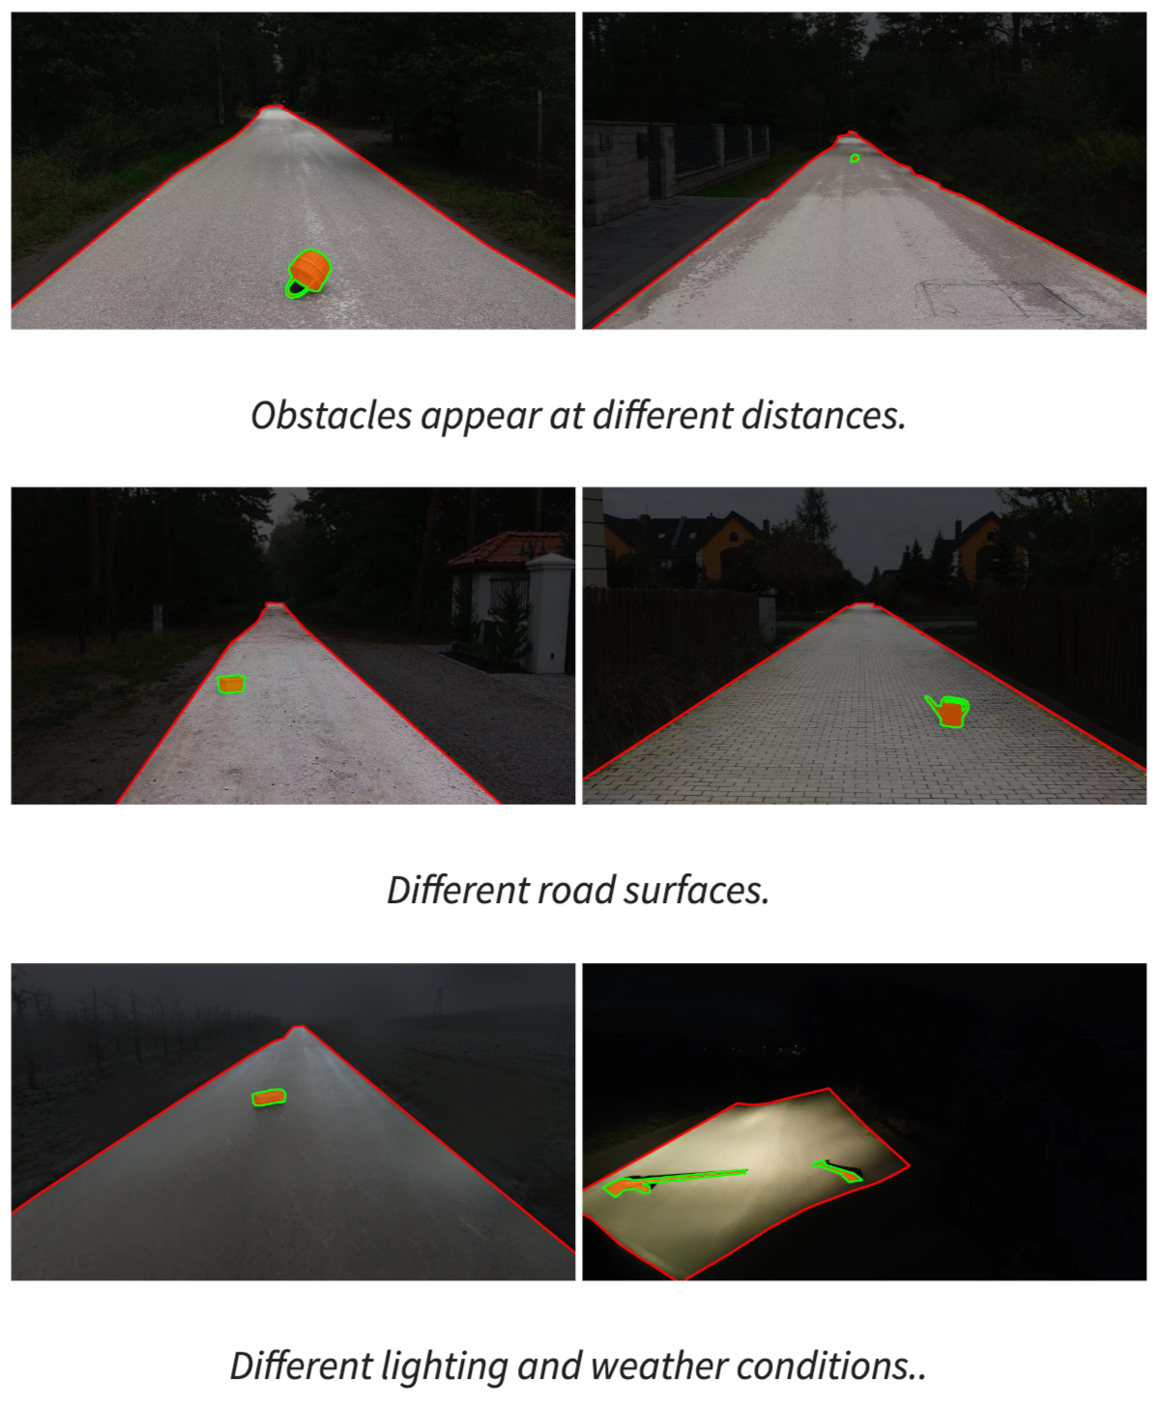
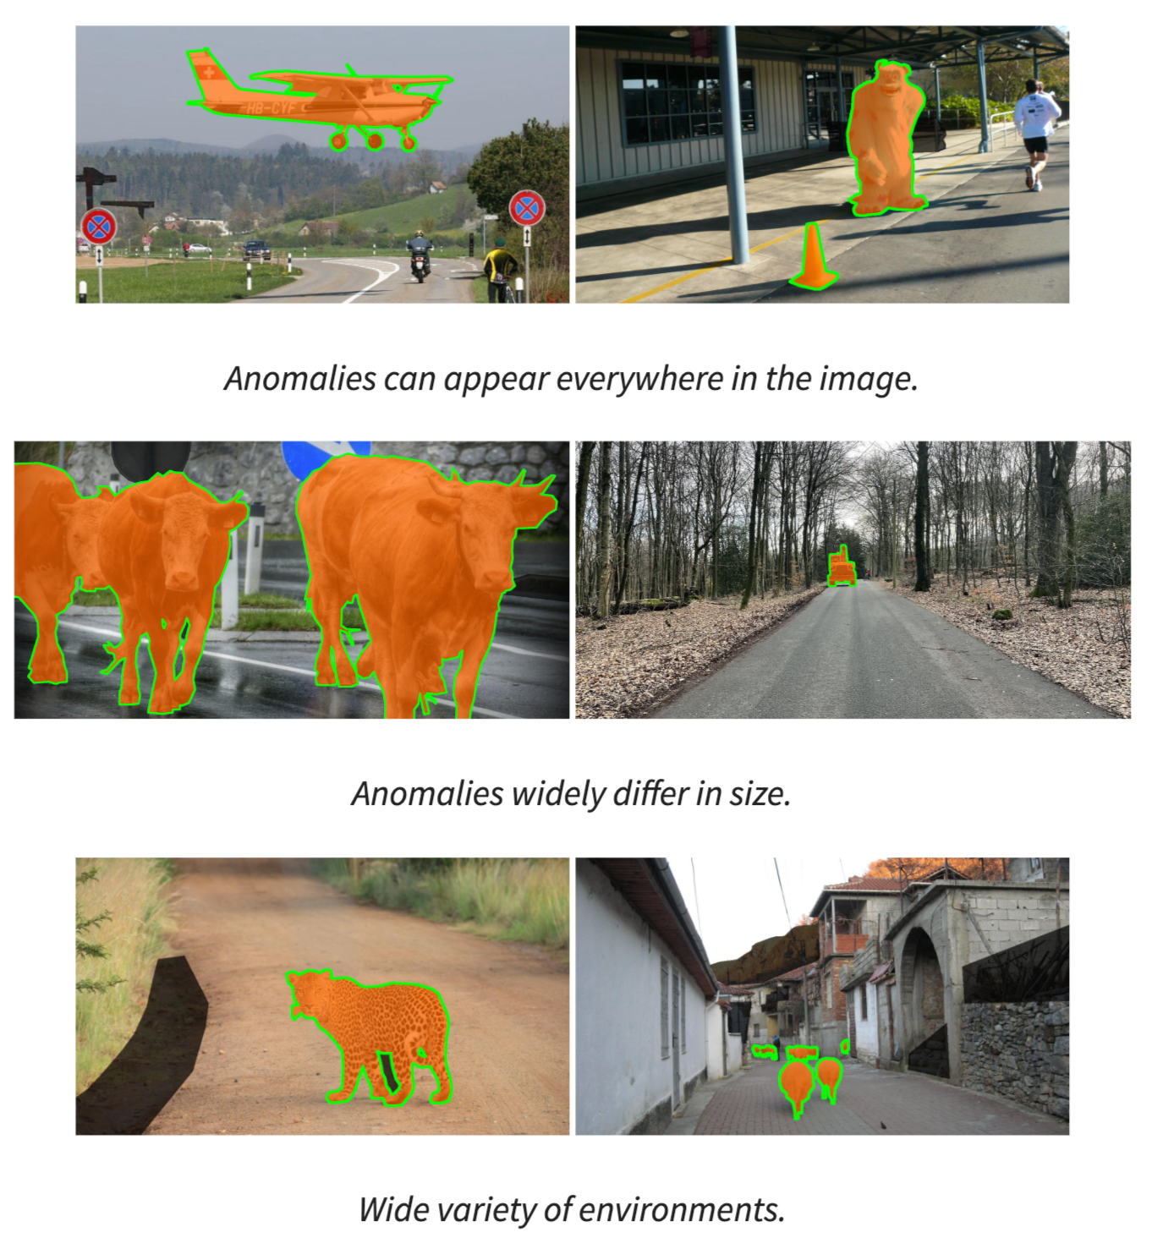
Challenges in Corner Cases
Varied Scenes
Diverse Objects
Varied Scenes
Small Objects
Contextual Anomaly
[A] Li Kaican et al., Coda: A real-world road corner case dataset for object detection in autonomous driving, in ECCV, 2022.
Notes:
However, improving autonomous systems isn’t just about handling routine tasks. Handling extreme corner cases is crucial for ensuring safe and reliable autonomous driving. These cases involve varied scenes, diverse and small objects, and contextual anomalies—all of which are critical to address for robust system performance.

Slide 5
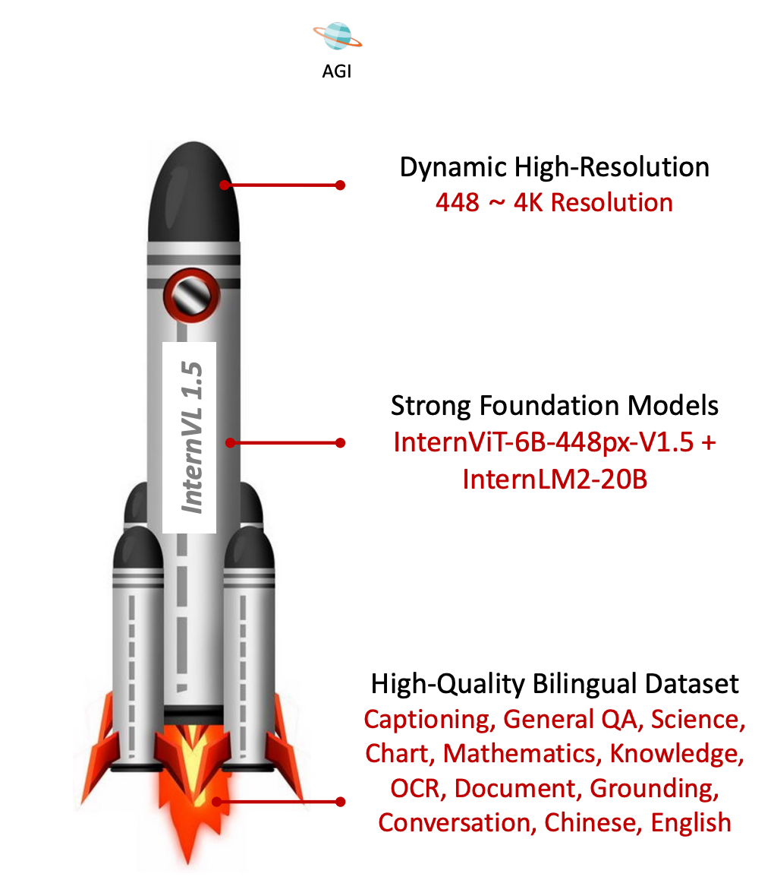
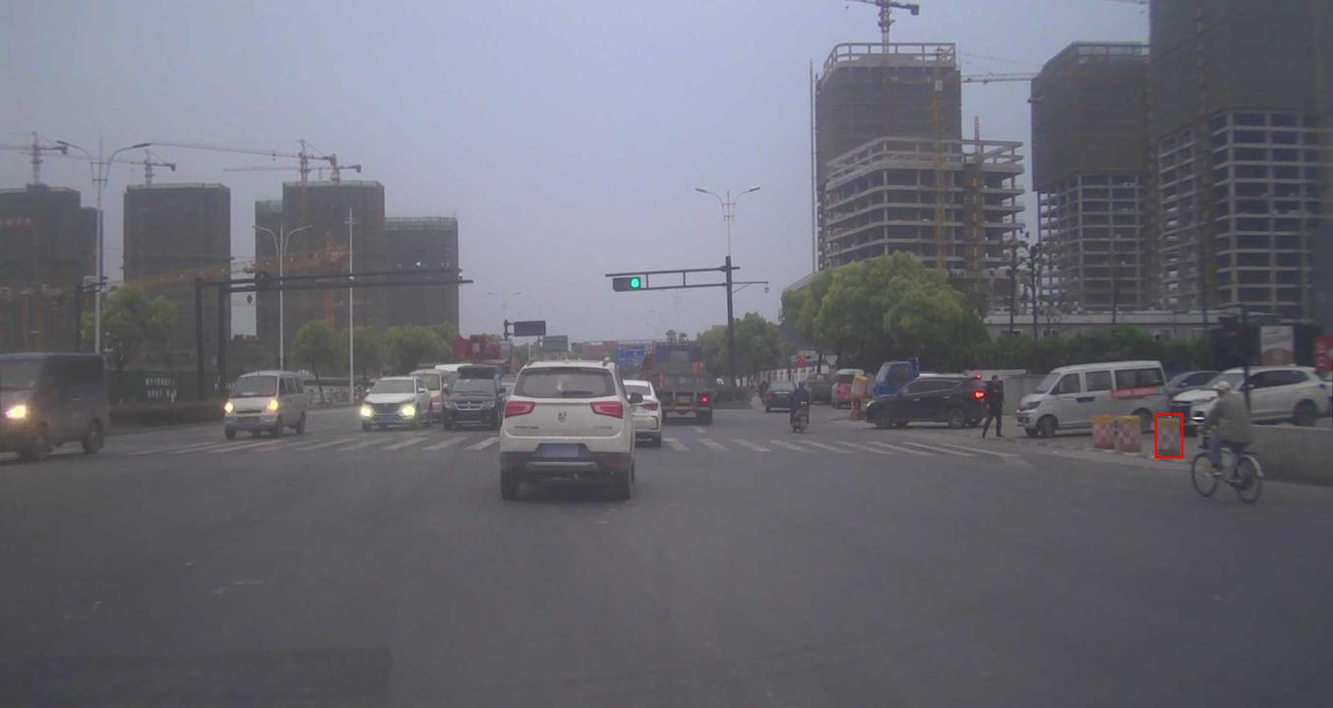
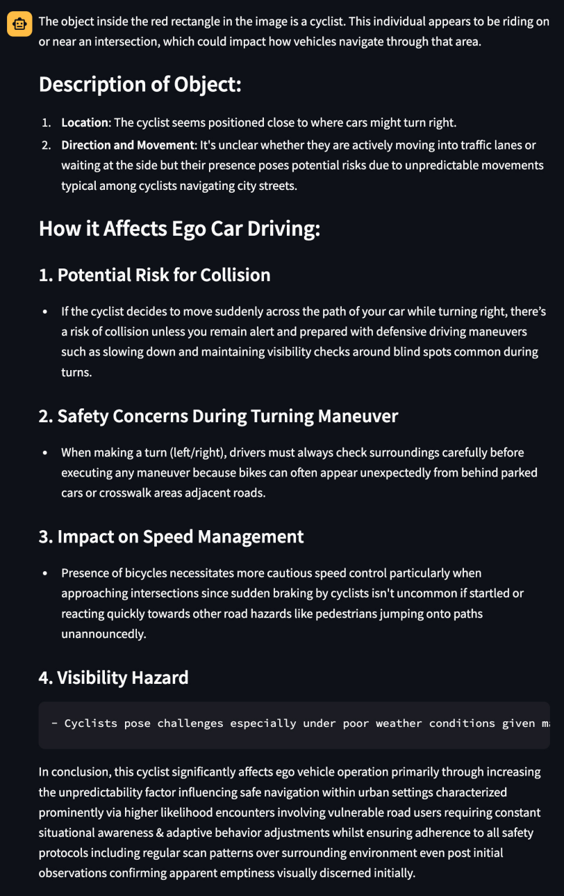
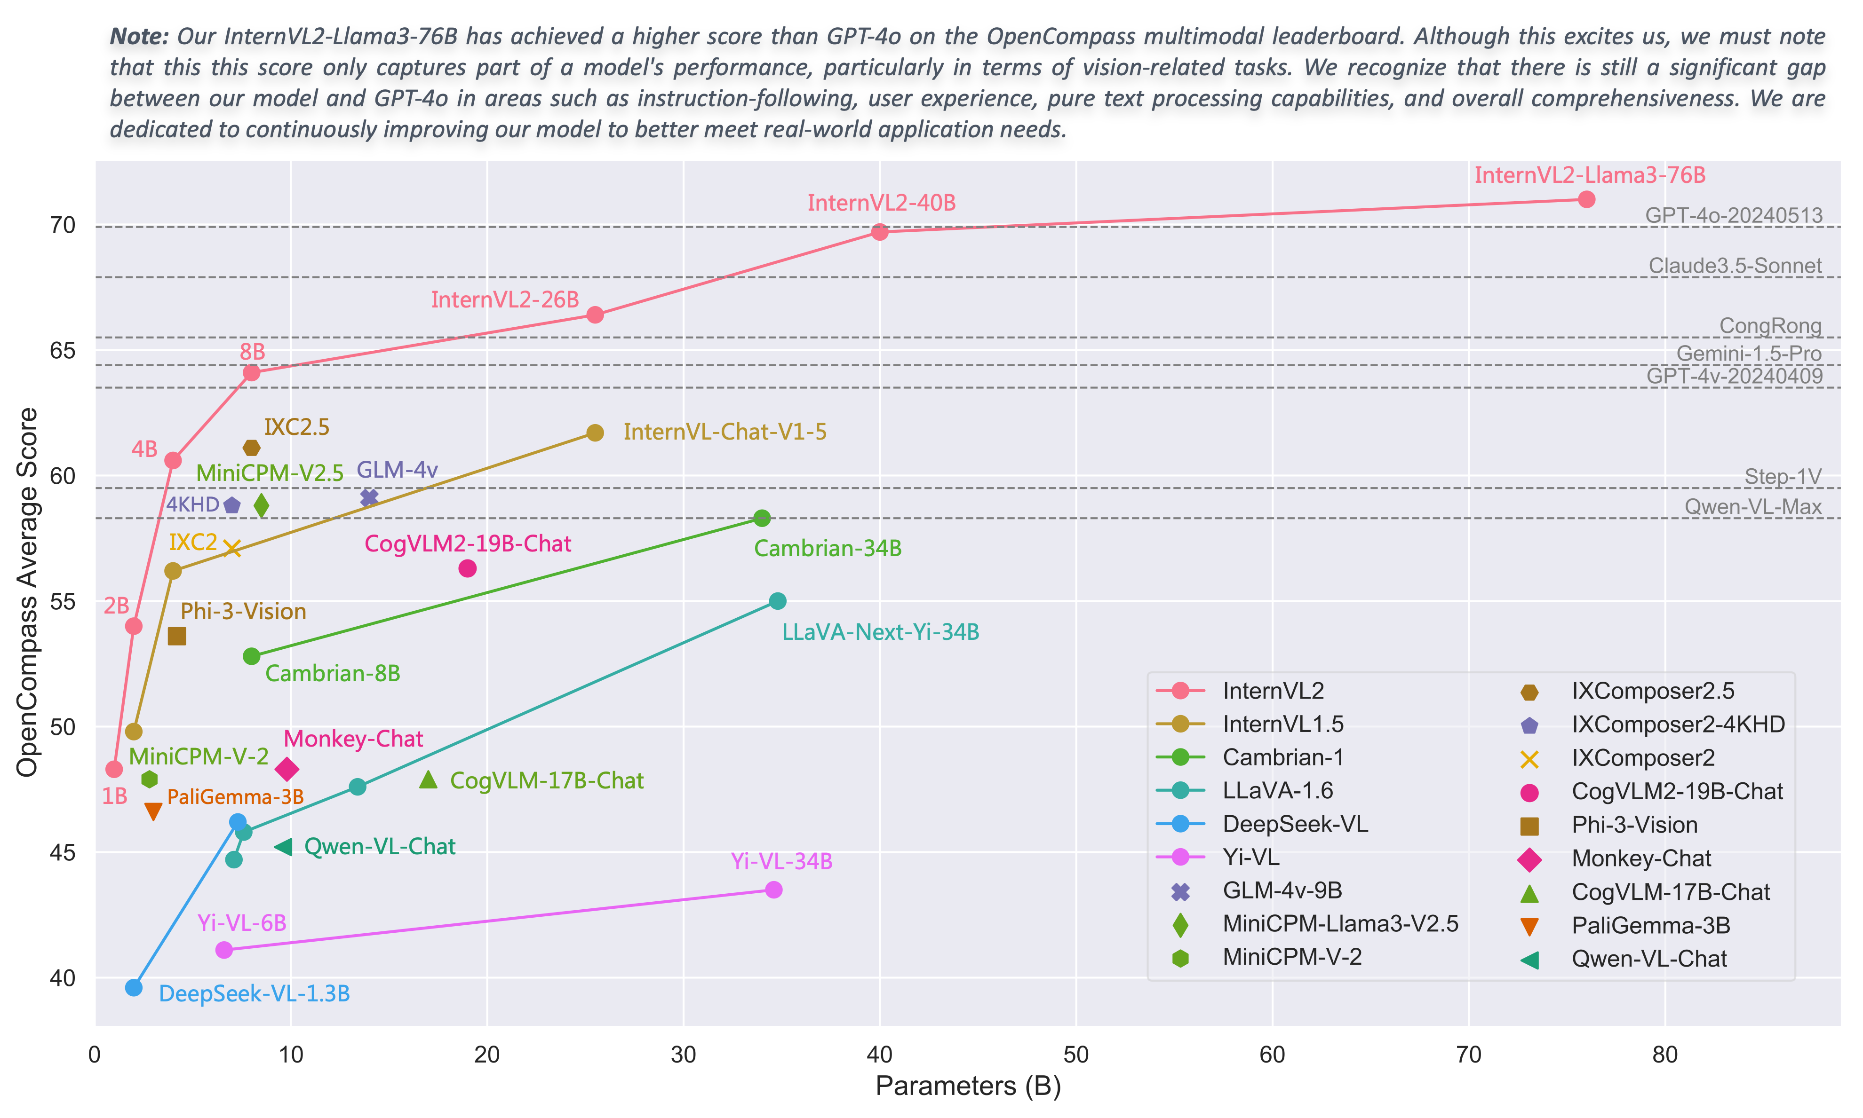
Regional Perception via Vision-Language Models
Query: Please describe the object inside the red rectangle in the image and explain why it affect ego car driving.
Answer: A barrier with orange and white stripes, indicating a temporary obstruction or hazard. The ego car must remain vigilant for any changes in the driving lane or potential rerouting due to this obstruction. It could indicate construction, a road closure, or an accident ahead, and drivers should be prepared to slow down or follow detour signs.
[A] Chen Zhe et al., Internvl: Scaling up vision foundation models and aligning for generic visual-linguistic task, in CVPR, 2024.
Notes:
We chose the InternVL family for its dynamic high resolution, supporting up to 4K. This enables more precise scene analysis.
On the right, you can see the InternVL-26B model output. While the model provides detailed semantic descriptions, there’s room for improvement in spatial awareness and reasoning. Enhancing these aspects will be key to better understanding complex driving environments.

Slide 6
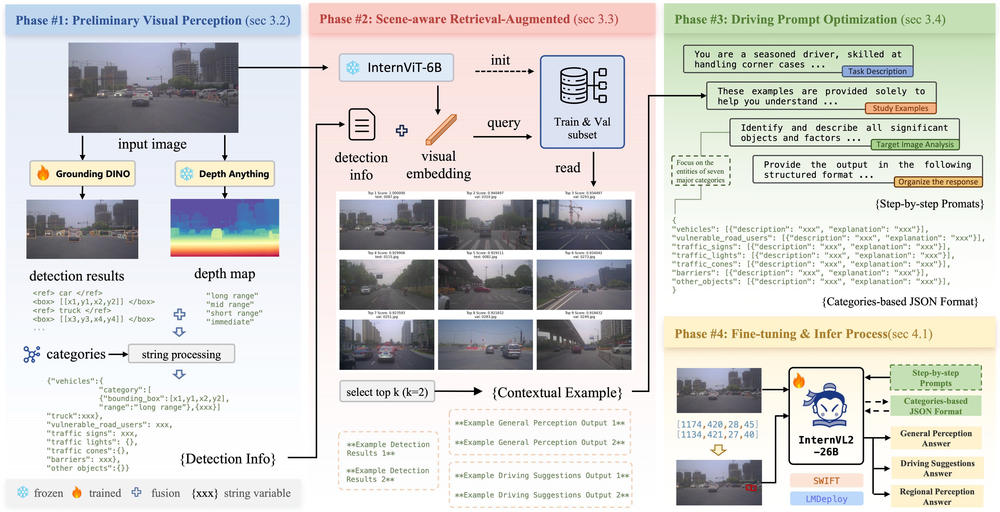
Overview of the proposed NexusAD framework
Notes:
Our NexusAD framework is designed to address the specific challenges of autonomous driving through four key phases:
Preliminary Visual Perception: We first process the input data using models like Grounding DINO for object detection and Depth Anything for depth estimation. This stage provides essential information about the environment, such as object localization and 3D structure, which are crucial for tasks like obstacle avoidance and path planning.
Scene-aware Retrieval-Augmented: In this phase, InternViT-6B queries a large-scale dataset of annotated scenes to retrieve the most contextually relevant visual embeddings. By selecting the top-k similar examples, the model can better understand scene dynamics, which aids in handling corner cases, such as unusual road conditions or rare object appearances.
Driving Prompt Optimization: The retrieved data is then used to generate structured driving suggestions through step-by-step prompts. This phase focuses on identifying and reasoning about key entities in the scene, such as vehicles, vulnerable road users, and traffic signs, all of which directly influence vehicle control strategies like speed adjustment or lane changes.
Fine-tuning & Inference Process: Finally, using the InternVL2-26B model, we fine-tune the system to optimize performance in tasks like general perception, driving suggestions, and regional perception. This ensures the system is robust in both normal driving conditions and critical corner cases.
Through these four phases, our framework enhances the system’s ability to perceive, reason, and respond to complex driving environments, making it more reliable for real-world autonomous driving scenarios.

Slide 7
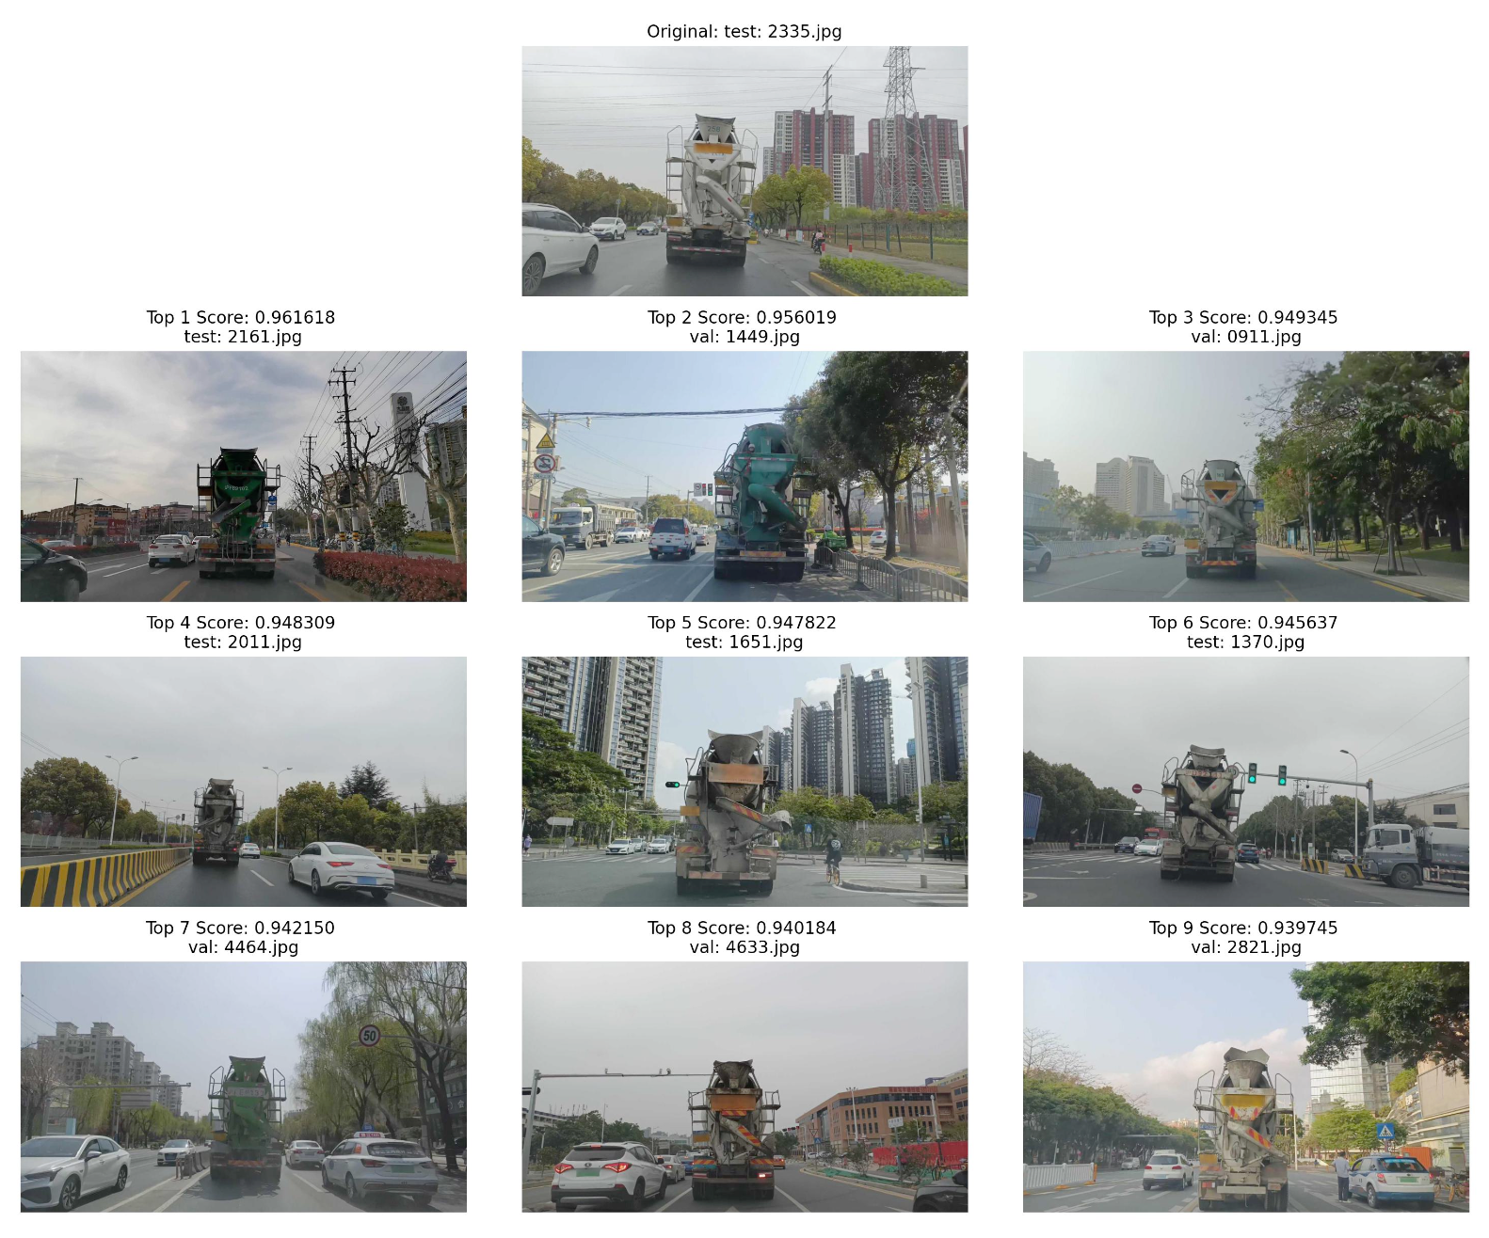
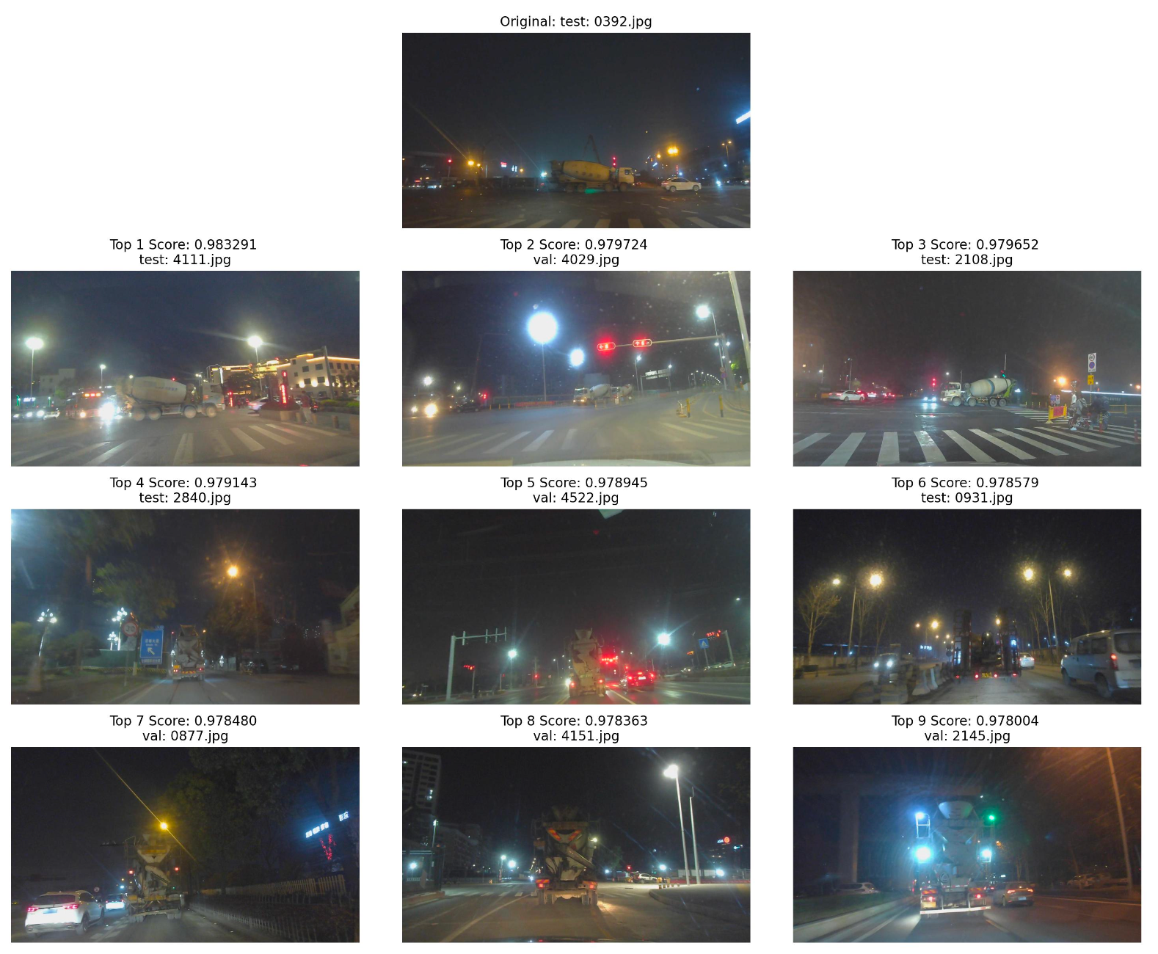
Visualization
Our method focuses on scene similarity, not just image similarity, allowing retrieval of the most relevant reference samples for the current driving scenario.
Notes:
Here, we present the visualization of our method’s results. Instead of relying purely on image similarity, our approach focuses on scene similarity to retrieve the most relevant reference samples for the current driving scenario.
As shown in these examples, the model is able to identify scenes with similar driving conditions, even when there are differences in irrelevant background elements. This helps the system make context-aware decisions, improving performance in challenging and diverse driving environments.

Slide 8
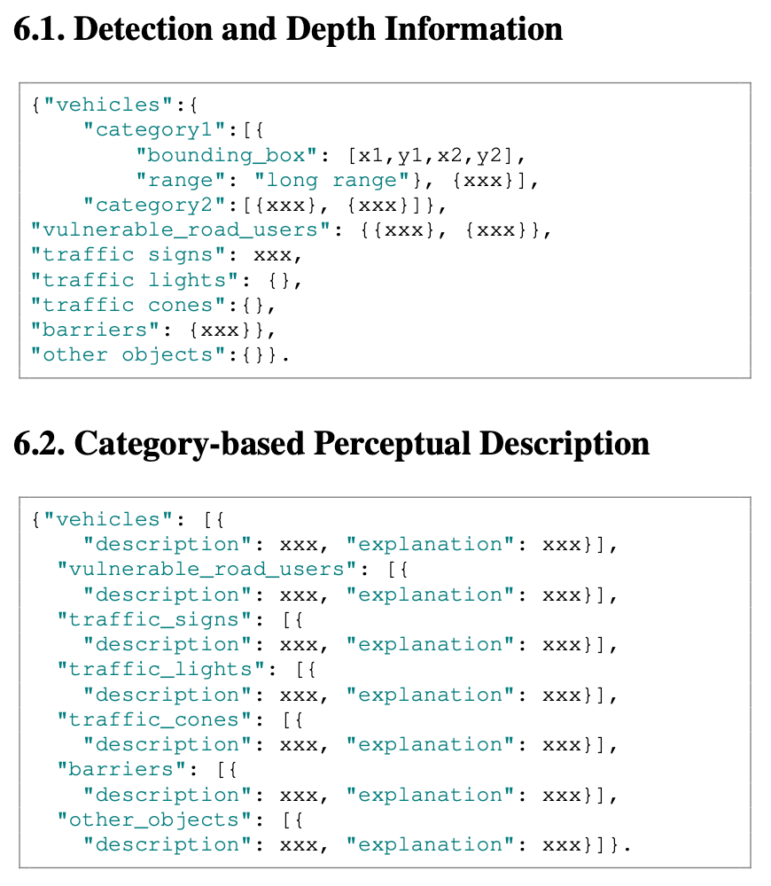
Suggestions provided by ChatGPT
Based on the analysis of these topics, I have the following suggestions to further optimize your VLM prompts:
Enhance specificity: Ensure that the prompt asks the model to provide precise and detailed operational suggestions, reducing vague or overly broad language. For example, in sections like "Speed Adjustments" and "Lane Positioning and Maneuvers," ask the model not only to indicate when speed adjustments or lane changes are necessary but also to explain how to perform these actions in detail.
Emphasize critical traffic elements: Make sure the model consistently focuses on key traffic elements, such as traffic lights, red lights, and important road signs. Consider adding a step in the prompt that directs the model to pay special attention to these critical elements and provide specific response strategies.
Avoid overgeneralization: Encourage the model to concentrate on the unique aspects of the current situation, avoiding overly generalized advice. You could include a section in the prompt reminding the model that each scenario is unique and requires a tailored response based on the specific elements detected.
Incorporate a feedback mechanism: If possible, implement a mechanism that allows the model to recheck and adjust its recommendations after generating an initial suggestion. This can help reduce low-quality responses caused by omissions or misunderstandings.
Minimize the influence of examples: If the examples are causing hallucinations, consider providing only strategic advice from the examples without including specific detection results. This approach can guide the model to focus on structure and depth rather than the specific details of the example.
These suggestions can be integrated into your current prompt version to better align with the characteristics of VLMs, improving the overall scoring of the final predictions.
Notes:
We’ve identified two important strategies that significantly boosted our performance:
Structured Data Formatting: In the additional materials, we utilized formatted data, such as detection and perceptual descriptions, to guide the model’s understanding. This structured approach helps the model interpret the scene more accurately, leading to better decision-making in real-time scenarios.
Utilizing Large Language Models: We also leveraged ChatGPT to summarize common patterns and best practices in extreme driving scenarios. These insights helped us refine our step-by-step prompts, enabling the model to provide more accurate and context-aware responses, particularly in corner cases.
By combining structured data and LLM-generated strategies, we were able to further optimize our model’s ability to handle complex autonomous driving situations.

Slide 9
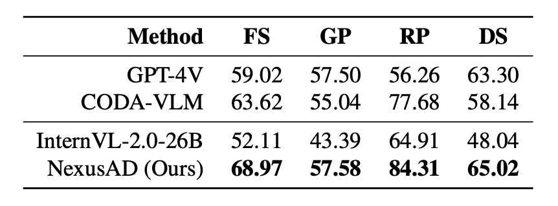
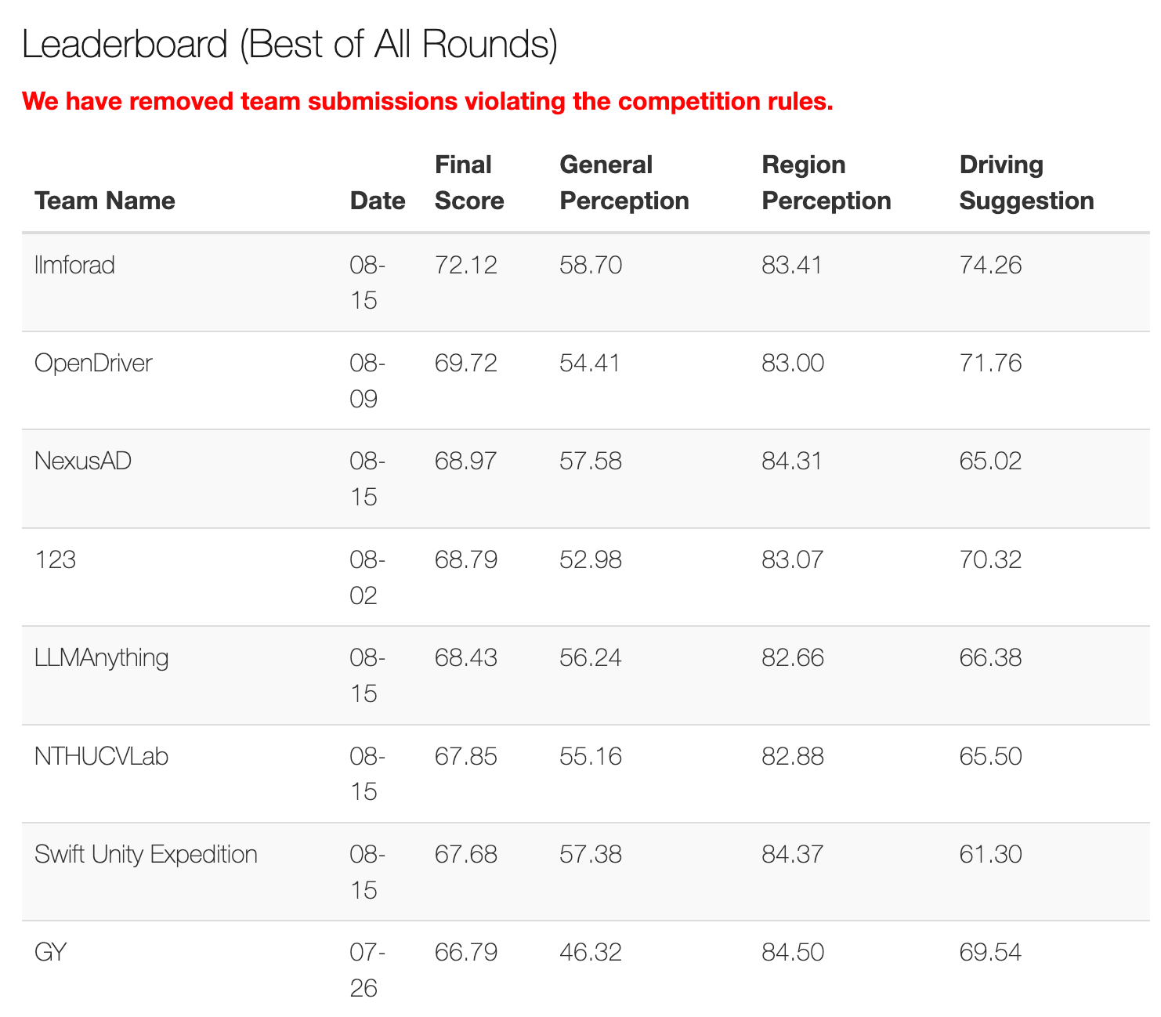
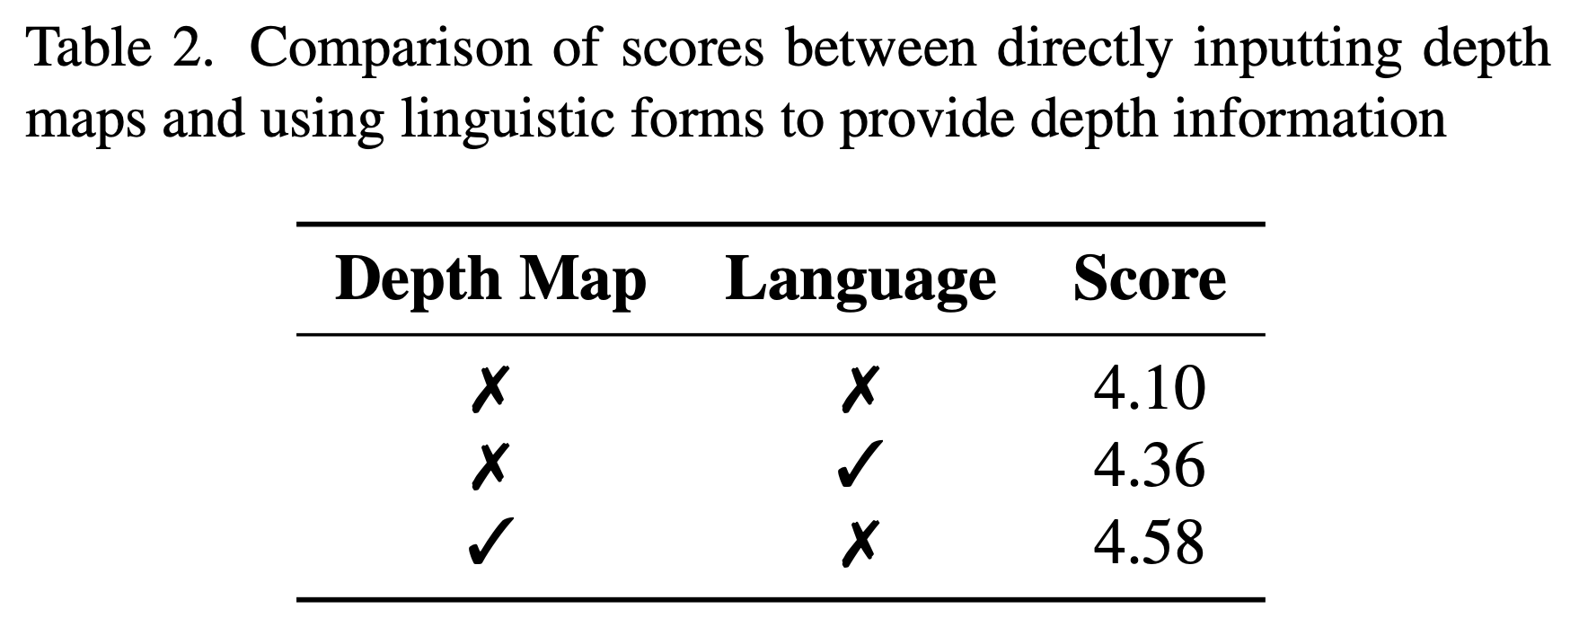
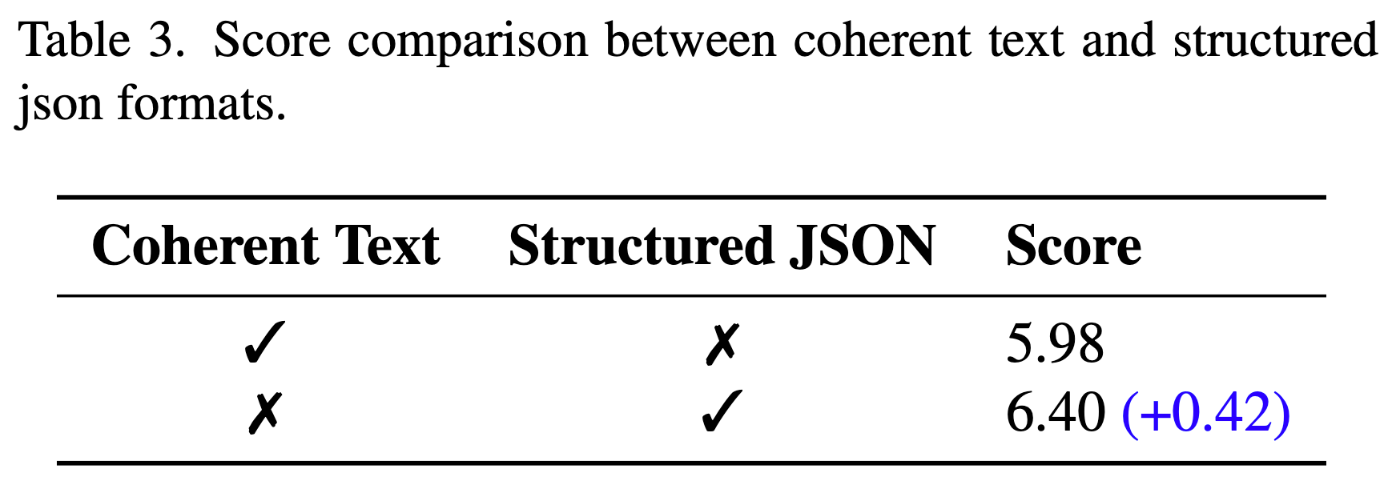
Results
Notes:
Our final score was 68.97, surpassing GPT-4V. This improvement was largely driven by our use of Scene-aware Retrieval-Augmented and step-by-step prompts, which helped us achieve significantly better performance compared to the baseline. These innovations allowed our model to better understand and respond to complex driving scenarios, resulting in a substantial score increase.

Slide 10
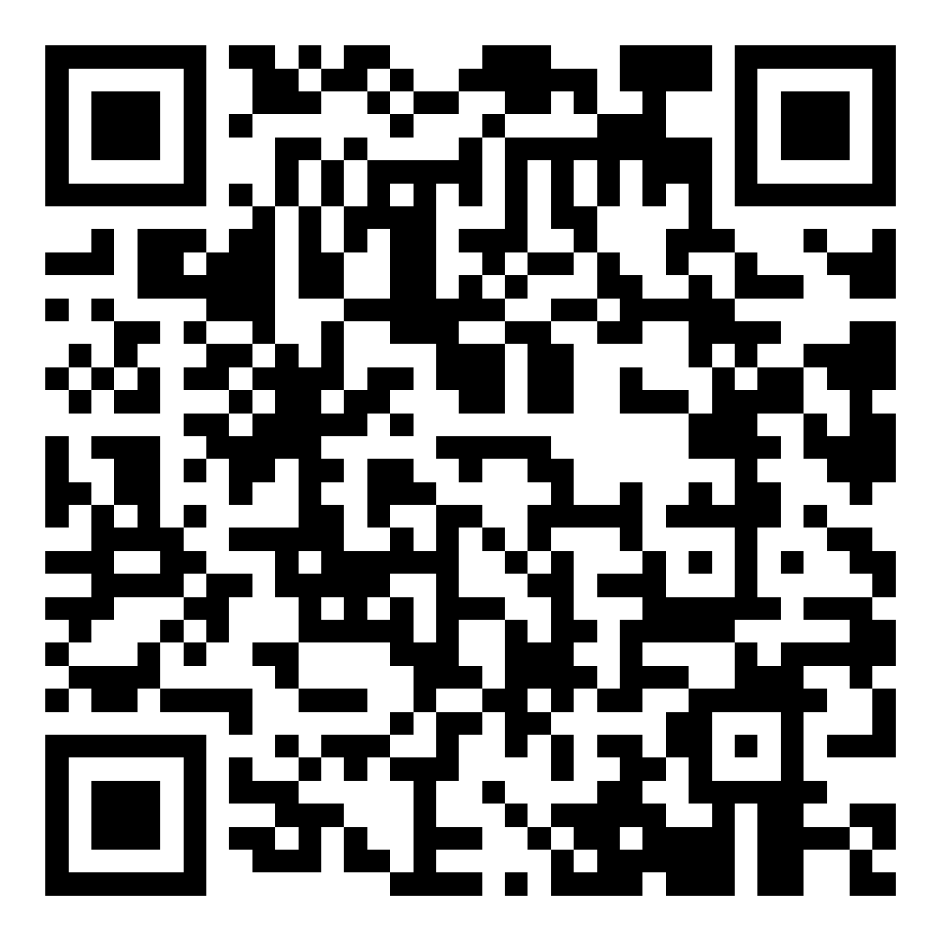
References:
[1] Li, Yanze, et al. "Automated evaluation of large vision-language models on self-driving corner cases." arXiv preprint arXiv:2404.10595 (2024).
[2] Chen, Zhe, et al. "Internvl: Scaling up vision foundation models and aligning for generic visual-linguistic tasks." Proceedings of the IEEE/CVF Conference on Computer Vision and Pattern Recognition. 2024.
[3] Li, Kaican, et al. "Coda: A real-world road corner case dataset for object detection in autonomous driving." European Conference on Computer Vision. Cham: Springer Nature Switzerland, 2022.
[4] Liu, Shilong, et al. "Grounding dino: Marrying dino with grounded pre-training for open-set object detection." European Conference on Computer Vision. Cham: Springer Nature Switzerland, 2024.
[5] Yang, Lihe, et al. "Depth anything: Unleashing the power of large-scale unlabeled data." Proceedings of the IEEE/CVF Conference on Computer Vision and Pattern Recognition. 2024.
GitHub Link
Multimodal Perception and Comprehension of Corner Cases in Autonomous Driving ｜Corner Case Scene Understanding
Workshop W-CODA
Sep. 30th, 2024 (Mon)
Notes:
Looking ahead, we hope to further explore the potential of large language models and their application in handling extreme corner cases in autonomous driving.
Thank you for your attention, and I’d like to thank the authors of the referenced works that have greatly informed our research. Feel free to scan the QR code for our GitHub link with more details. I'm happy to take any questions.

